Slide 1
SIMATS ENGINEERING
SIMATS
CSA0823-PYTHON PROGRAMMING FOR DATA SCIENCE
MINI PROJECT – MARCH 2024
Tic Tac Toe Quest: Master the Board
PRESENTED BY:
Jaya suriya (192221092)
Naresh Kumar T(192221093)
Shanmugarajan AL(192221101)
Guided by:
Dr.S.Kalaiarasi B.E,M.E,Ph.D

Slide 2



ABSTRACT:
The Tic Tac Toe game is a classic two-player strategy game played on a 3x3 grid. It is a simple yet engaging game where players take turns marking spaces on the grid with their respective symbols (X or O) with the objective of forming a horizontal, vertical, or diagonal line of their symbols. This project aims to implement the Tic Tac Toe game using Python programming language and the Pygame library to provide a graphical user interface.The game allows two human players to take turns playing against each other on the same device. Players can click on the grid squares to place their symbols, and the game automatically detects winning conditions and announces the winner.
Additionally, the game includes features such as a reset button to start a new game and a visual indicator of the current player's turn.The implementation of the Tic Tac Toe game serves as an excellent exercise for beginners to understand basic game development concepts, including game logic, user interaction, and graphical representation. Furthermore, it provides an enjoyable and interactive experience for players of all ages, making it a popular choice for recreational purposes.

Slide 3
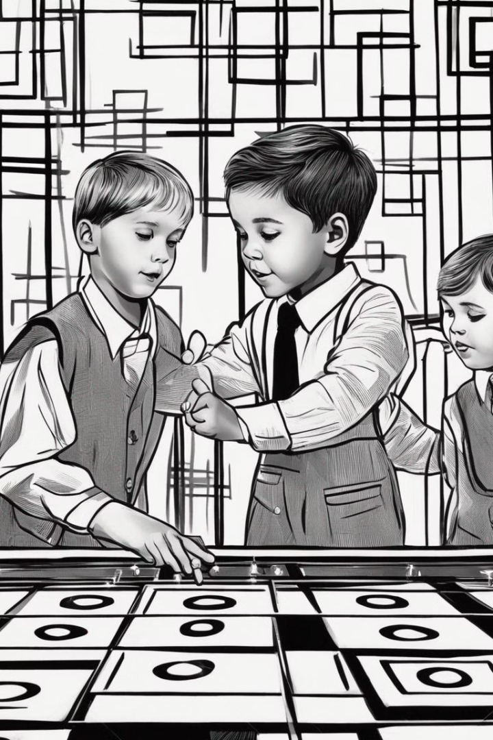
Introduction to Tic Tac Toe
One of the most universally played childhood games is TIC TAC TOE. An interactive TIC TAC TOE game is developed where two players will be able to play against each other in a suitable GUI by using proper mouse movements. This game will start by showing a simple display, prompt the user for a move and then prints the new board. The board looks like a large hash symbol (#) with nine slots that can each contain an X, an O, or a blank. There are two players, the X player and the O player. By default, player1 (the O player) takes the initiative. The game will end in two situations: a win, when one player gets three in a row, horizontally, vertically or diagonally. A draw, when there are no remaining places to choose and neither of them has won. Here are some rules for the game:
The player with symbol ‘O’ goes first
Players alternate placing X s and O s on the board until either
one player has three in a row, horizontally, vertically or diagonally; or
All nine squares are filled.
The player who can draw three X s or three O s in a row wins.
If all nine squares are filled and none of the players have three in a row, the game is a draw.

Slide 4
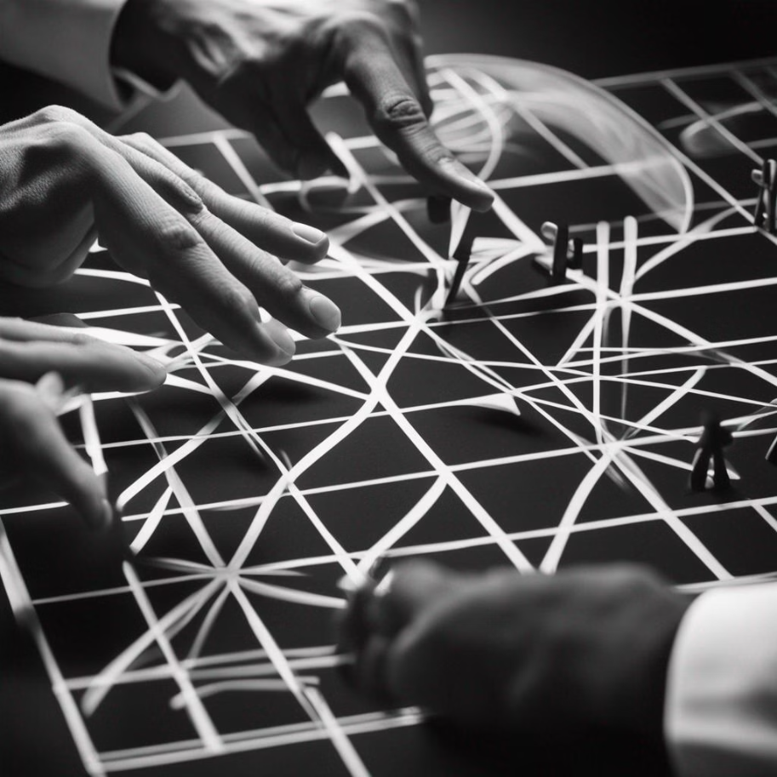
Basic Rules and Gameplay
Objective
Turns
Strategy
The goal is to form a row of three X's or O's either horizontally, vertically, or diagonally.
Players take turns placing their X's or O's in the grid, with the first player using X.
Players need to anticipate their opponent's moves and plan their own to create winning combinations.

Slide 5
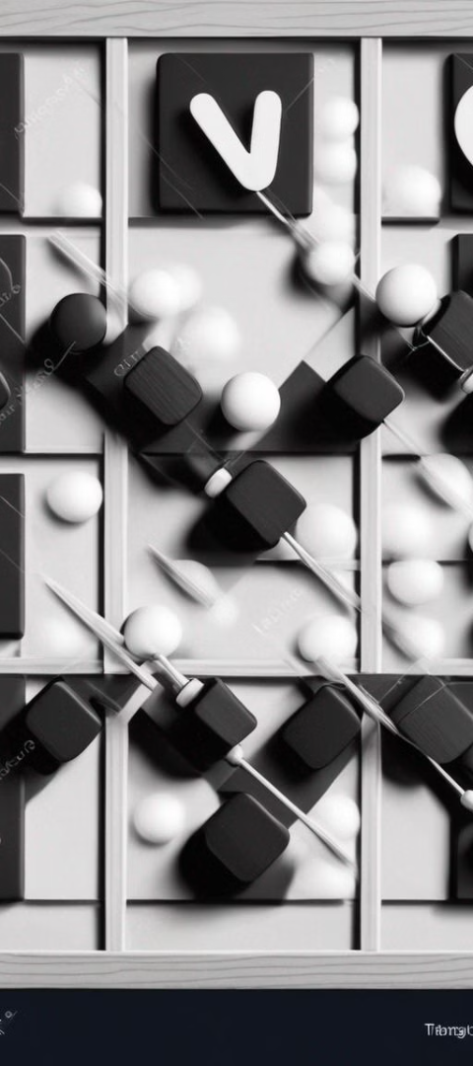
Strategies for Winning
1
Corner Strategy
Start in a corner to have the most opportunities for winning combinations.
2
Block Opponent
Keep an eye on stopping your opponent's potential winning moves.
3
Focus on Center
If the opponent doesn't start in a corner, take the center spot for an advantageous position.

Slide 6
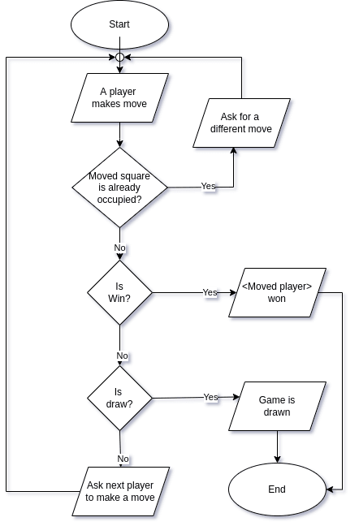

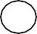
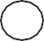
Architecture Diagram
Start Game
Player 1
moves
Player 2
moves
Check the
result
Player 1
Player 2
Play again

Slide 7
MODULES
1.PY-GAME
Python is the most popular programming language or nothing wrong to say that it is the next generation programming language.
In every emerging field in computer science, Python makes its presence actively Python has vast libraries for various fields such as Machine Learning (Numpy, Pandas,
Matplotih), Artificial intelligence
(Pytorch, TensorFlow), and Game development
Game programming is very rewarding nowadays and it can also be used in advertising and as a teaching tool too. Game development includes mathematics, logic, physics, AL, and much more and it can be amazingly fine. In python, game programming is done in pygame and it is one of the best modules for doing so
Pygame is a cross-platform set of Python modules which is used to create video games. It consists of computer graphics and sound libraries designed to be used with the Python programming language. Pygame was officially written by Pete Shinners to replace PySDL. Pygame is suitable to create client-side applications that can be potentially wrapped in a standalone executable.
Sys:
The sys module is a built-in Python module that provides access to some variables and functions that interact with the Python interpreter. It is often used for system-specific parameters and functions, allowing Python programs to interact with the runtime environment and operating system.
The sys module provides access to various system-specific parameters, such as the Python version (sys.version), the maximum size of integers (sys.maxsize), and the platform identifier (sys.platform), which indicates the underlying operating system.
the sys module is a versatile tool for accessing system-specific parameters, interacting with the Python interpreter, and performing various system-level operations within Python programs.
The sys module is a built-in Python module that provides access to some variables and functions that interact with the Python interpreter. It is often used for system-specific parameters and functions, allowing Python programs to interact with the runtime environment and operating system.
The sys module provides access to various system-specific parameters, such as the Python version (sys.version), the maximum size of integers (sys.maxsize), and the platform identifier (sys.platform), which indicates the underlying operating system.

Slide 8
Source Code:
import pygame
import sys
pygame.init()
WIDTH, HEIGHT = 300, 300
LINE_COLOR = (0, 0, 0)
BG_COLOR = (255, 255, 255)
LINE_WIDTH = 5
CELL_SIZE = WIDTH // 3
X_COLOR = (255, 0, 0)
O_COLOR = (0, 0, 255)
screen = pygame.display.set_mode((WIDTH, HEIGHT))
pygame.display.set_caption("Tic Tac Toe")
def draw_grid():
for i in range(1, 3):
pygame.draw.line(screen, LINE_COLOR, (0, i * CELL_SIZE), (WIDTH, i * CELL_SIZE), LINE_WIDTH)
pygame.draw.line(screen, LINE_COLOR, (i * CELL_SIZE, 0), (i * CELL_SIZE, HEIGHT), LINE_WIDTH)
def draw_XO(row, col, symbol):
x = col * CELL_SIZE + CELL_SIZE // 2
y = row * CELL_SIZE + CELL_SIZE // 2
if symbol == "X":
pygame.draw.line(screen, X_COLOR, (x - CELL_SIZE // 4, y - CELL_SIZE // 4), (x + CELL_SIZE // 4, y + CELL_SIZE // 4), LINE_WIDTH)
pygame.draw.line(screen, X_COLOR, (x + CELL_SIZE // 4, y - CELL_SIZE // 4), (x - CELL_SIZE // 4, y + CELL_SIZE // 4), LINE_WIDTH)
elif symbol == "O":
pygame.draw.circle(screen, O_COLOR, (x, y), CELL_SIZE // 4, LINE_WIDTH)
def get_row_col_from_pos(pos):
x, y = pos
row = y // CELL_SIZE
col = x // CELL_SIZE
return row, col
def is_winner(board, symbol):
for row in board:
if all(cell == symbol for cell in row):
return True

Slide 9
Source Code:
for col in range(3):
if all(board[row][col] == symbol for row in range(3)):
return True
# Check diagonals
if all(board[i][i] == symbol for i in range(3)) or all(board[i][2 - i] == symbol for i in range(3)):
return True
return False
def main():
running = True
board = [[" " for _ in range(3)] for _ in range(3)]
current_symbol = "X"
winner = None
while running:
screen.fill(BG_COLOR)
draw_grid()
for event in pygame.event.get():
if event.type == pygame.QUIT:
running = False
pygame.quit()
sys.exit()
if event.type == pygame.MOUSEBUTTONDOWN and not winner:
pos = pygame.mouse.get_pos()
row, col = get_row_col_from_pos(pos)
if board[row][col] == " ":
board[row][col] = current_symbol
if is_winner(board, current_symbol):
winner = current_symbol
else:
current_symbol = "O" if current_symbol == "X" else "X“

Slide 10
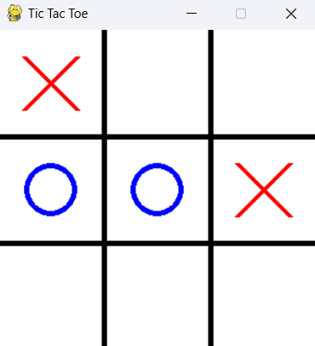
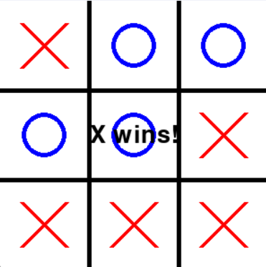
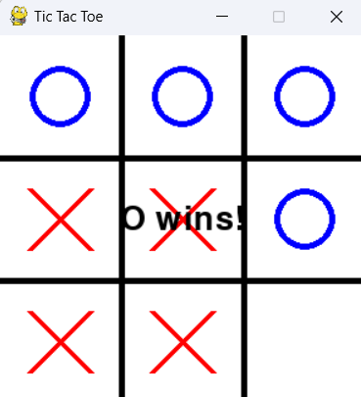
Output Screenshots:

Slide 11
Built-in Functions:
1. pygame.init():- This function initializes all Pygame modules. It must be called before any other Pygame functions are used.
2. pygame.display.set_mode():- This function creates a window surface for displaying graphics. It takes the width and height of the window as parameters and returns a Surface object representing the window.
3. pygame.draw.line():- This function draws a straight line on a Surface. It takes parameters such as the Surface to draw on, color, starting point, ending point, and line width.
4. pygame.draw.circle(): - This function draws a circle on a Surface. It takes parameters such as the Surface to draw on, color, center coordinates, radius, and line width.
5. pygame.mouse.get_pos():- This function returns the current position of the mouse cursor as a tuple of x and y coordinates.
User Defined Function:
1. draw_grid(): - This function draws the grid lines for the Tic Tac Toe board.
2. draw_XO(row, col, symbol):- This function draws either an X or an O symbol on the board based on the provided row, column, and symbol.
3. get_row_col_from_pos(pos):- This function converts the mouse cursor position (x, y) into row and column indices on the game board.
4. is_winner(board, symbol):- This function checks if a player with the specified symbol has won the game by examining the board for winning combinations

Slide 12



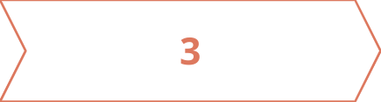
Fun Facts about Tic Tac Toe
Historical Game
Global Popularity
Perfect Games
Tic Tac Toe dates back to ancient Egypt and the Roman Empire.
It's known by different names in various countries, such as "noughts and crosses".
When played optimally, Tic Tac Toe results in a draw every time.

Slide 13
Conclusion:
Gameplay Evaluation: Tic Tac Toe is a simple yet engaging game suitable for all ages.
It offers a balance between strategy and simplicity, making it accessible to a wide audience.
Algorithmic Strategies: Various strategies have been developed to play Tic Tac Toe optimally, including
brute-force methods for perfect play and heuristic approaches for more practical gameplay.
These strategies enhance the game's depth and provide players with opportunities to improve their skills.
Implementation Variations: Tic Tac Toe can be implemented in numerous ways, ranging from basic console
applications to sophisticated graphical interfaces with advanced AI opponents. The flexibility in implementation
allows for creativity and innovation in game design.

Slide 14
